Slide 1
The ESI Protocol
By: Marlo P. Cadeddu
Law office of Marlo P. Cadeddu, P.C.
www.marlocadeddu.com

Slide 2
ESI – A definition
ESI is “Electronically Stored Information”
Any information created, stored, or utilized with digital technology
Stored anywhere – computer, external device, CD/DVD, cellphone, Cloud

Slide 3
Why an ESI Protocol – the Paradigm Shift
In 1996, only 5% of discoverable documents derived from electronic format
12 years later by 2008, more than 93% of all business documents were created electronically - trend continues
1TB = 220 million pages of text
Looking at each page of 220,000,000 pages for 10 seconds only would take 70 years
10TB would hold entire digitized contents of library of congress

Slide 4
Introduction - ESI Protocol
Official title is “Recommendations for Electronically Stored Information (ESI) Discovery Production in Federal Criminal Cases”
Produced by a joint task force of DOJ and the Administrative Office of the US Courts
Framework for communications between parties re: ESI
Framework for ESI production
Framework for Resolving ESI disputes

Slide 5
Key Principles
Responsibility of lawyers to understand ESI
No additional conversion or processing costs beyond those incurred or planned for own case
Meet and confer and good faith efforts to resolve ESI disputes
Parties should jointly seek production formats and transmission methods that are cost effective & usable

Slide 6
Structure of ESI Protocol
3 part document:
Recommendations – general framework
Strategies and commentary – practical, technical guidance and definitions
Checklist

Slide 7
Part 1 of the ESI Protocol:
Recommendations

Slide 8
Recommendations - Purpose
ESI Protocol seeks to balance goals:
Compliance with legal discovery obligations
Impossibility of document by document review, so need to use software search, management tools
Avoid unnecessary duplication of time and expense
ESI in industry standard format
No additional processing required of producer
Ensure protection of privilege, work product, protected info

Slide 9
Recommendations – Scope and Limitations
ESI Protocol not intended for use in every case
ESI Protocol does not alter parties’ discovery obligations or create new rights or privileges
ESI Protocol not a basis for misconduct claims or claims for relief

Slide 10
Recommendations - Other
Involve technical people in the process
Use meet and confer as an ESI planning meeting and anticipate issues:
Incarcerated defendant
Non-releasable ESI (porn)
Classified data

Slide 11
Recommendations – ESI Production
Key issues:
ESI Production Format
ESI Transmission

Slide 12
Recommendations – ESI Production (cont’d)
Format
Examples of types of format – pdf, tiff, text, OCR, load files, native file production
Discuss format of production with government – use industry standards
Format of third party discovery – format of original production or “reasonably usable” format

Slide 13
Recommendations – ESI Production (cont’d)
Transmission
How will you get the ESI? - Cloud, on media, external hard drives, internal hard drives
Production should promote efficiency, security and reduce costs
Producing party needs to keep record of production
All media clearly labeled

Slide 14
Recommendations - Other
Consider a Coordinating Discovery Attorney in multi-defendant cases
Discuss protecting privileged, work product, confidential information in the ESI
Confer to resolve disputes prior to involving court

Slide 15
Part 2 of the ESI Protocol:
Strategies and Commentary

Slide 16
Strategies and Commentary
Useful information:
List of types of discovery
Recommendation re: production of Table of Contents of ESI
Handling of special issues, e.g.:
Proprietary ESI formats
Incarcerated defendants
ESI discovery volume

Slide 17
Strategies and Commentary (cont’d)
Descriptions, options for production of various types of ESI:
EXAMPLE - Paper production – 3 formats suggested:
Single page TIFFS with associated OCR file
Multi-page TIFFS with associated OCR file
Multi-page PDFs that are OCRed
Usability key – note OCR recommendation

Slide 18
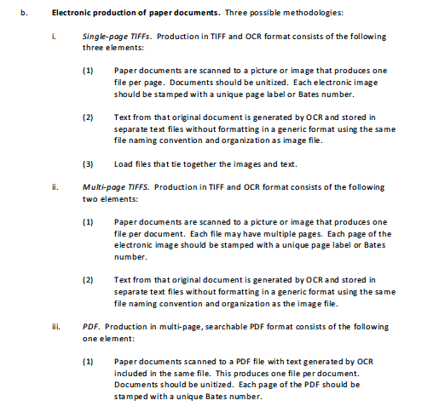

Slide 19
Strategies and Commentary (cont’d)
Best part of the ESI Protocol – DEFINITIONS
EXAMPLE – Cloud Computing:
With cloud computing, the user accesses a remote computer hosted by a cloud service provider over the Internet or an intranet to access software programs or create, save, or retrieve data, for example, to send messages or create documents, spreadsheets, or databases. Examples of cloud computing include Gmail, Hotmail,Yahoo! Mail, Facebook, and on-line banking.

Slide 20
Part 3 of the ESI Protocol:
ESI Discovery Production Checklist

Slide 21
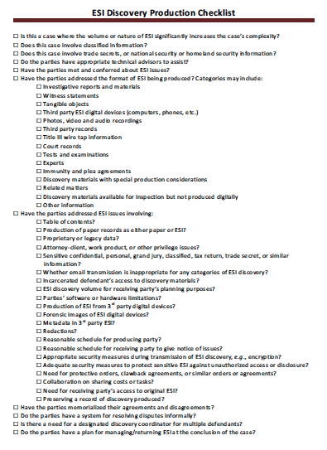

Slide 22
Marlo’s ESI Tips
Memorialize meet and confer agreements
Keep a running inventory of ESI received, dates, media, format
If accessible format, check upon receipt to make sure files will open
Try to get consolidated data productions
Be wary of the government’s use of security protections for strategic advantage

Slide 23
Important ESI Cases – Searchability is key
US v. Briggs, 2011 WL 4017886 (WDNY 2011) – gov’t ordered to “reproduce[e] … ESI in a fashion that defendants can retrieve and manipulate.”
US v. Skilling, 554 F.3d 529, 577 (5th Cir. 2009) (rev’d on other grounds) – voluminous open file doesn’t violate Brady b/c in Skilling gov’t provided electronic, indexed searchable database and hot docs.
US v. Ohle, 2011 WL 651849 (SDNY 2011) – gov’t met Brady obligations because gave documents an electronically searchable Concordance database.
US v. Rubin, 825 F.Supp.2d 451 (SDNY 2011) – no Brady violation b/c materials disclosed “are electronic and searchable.”

