Slide 1
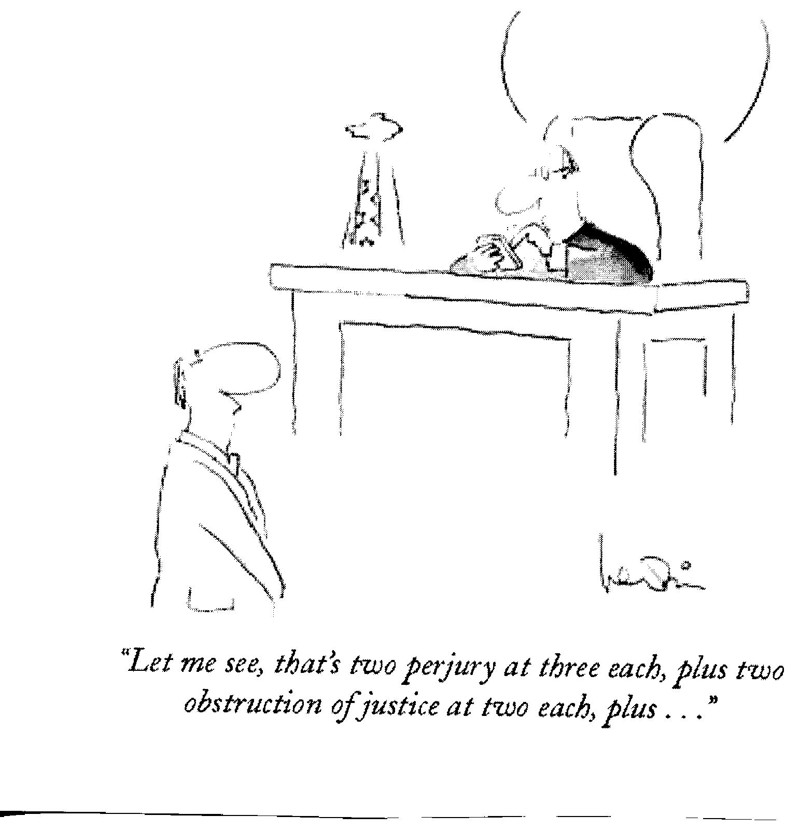
Sentencing 101: Introduction to Federal Sentencing
April 23, 2010
Presented by Marlo P. Cadeddu
Based upon Sentencing 101: Fundamentals of Federal Criminal Practice by Alan Dorhoffer, United States Sentencing Commission and Stephen Marley, Office of Defender Services Training Branch

Slide 2
History of the Federal Sentencing guidelines

Slide 3
The birth of the federal sentencing guidelines
Enactment of Sentencing Reform Act of 1984
Creation of United States Sentencing Commission
Charged with drafting sentencing guidelines

Slide 4
Purposes and Initial Considerations
Was attempt to reform system make system more fair
Goals: honesty and uniformity
Real offense versus charge offense system
USSG § 1A1.1

Slide 5
Drafting of the sentencing guidelines
Sentencing Commission looked at factors historically used in sentencing
E.g. recidivism, number of victims etc.
Statistical analysis of sentencing factors
Incorporated policy considerations
Created sentencing guidelines system
Standardized application of sentencing factors
Departure mechanism to account for differences among defendants

Slide 6
General Approach of the Federal Sentencing Guidelines
Hybrid charge offense-real offense system
Begins as an offense of conviction system
Then considers many real offense characteristics
“Relevant conduct” provision is major mechanism for injecting real offense characteristics

Slide 7
Sentencing Guidelines Milestones
Mistretta v. United States, 488 U.S. 361 (1989)
Held guidelines constitutional
Koon v. United States, 518 U.S. 81 (1996)
Established abuse of discretion standard of review for departures
Feeney Amendment to the PROTECT Act of 2003
Limited departures in child and sex cases.
Changed standard of review for departures to de novo
Prohibited new departure grounds on remand
Required government motion for third acceptance of responsibility point
Required courts to explain and document bases for departures
Almendarez-Torres, 523 U.S. 224 (1998).
Fact of a prior conviction is merely sentencing factor
Treatment of recidivism as sentencing factor rather than element of offense does not violate due process (prior conviction exception)

Slide 8
The shot across the bow…
Apprendi v. New Jersey, 530 U.S. 466 (2000).
Any fact that increases penalty beyond statutory maximum must be submitted to a jury and proven beyond a reasonable doubt
Sentencing factor = element
Expressly exempts prior convictions (Almendarez-Torres)

Slide 9
The beginning of the end…
Blakely v. Washington, 124 S.Ct. 2531 (2004).
Redefined Apprendi statutory maximum as maximum sentence judge may impose based solely on facts in jury verdict or admitted by defendant
Held: any fact that increases penalty for crime beyond statutory maximum must be:
Submitted to jury; and
Proved beyond a reasonable doubt
Invalidated Washington state’s sentencing guideline system

Slide 10
“It’s the end of the world as we know it” Judge Kinkeade on the guidelines (quoting REM)
United States v. Booker, 125 S.Ct. 738 (2005).
Merits majority: Blakely applies to the federal sentencing guidelines
Remedial majority: The federal sentencing guidelines are advisory; all sentences must be “reasonable”

Slide 11
Post-Booker
United States v. Rita, 127 S.Ct. 2456 (2007)
Within guidelines sentence can be afforded presumption of reasonableness on appellate review.
Gall v. United States, 128 S.Ct. 586 (2007)
sentencing courts may not require extraordinary circumstances in order to impose a non-guidelines sentence.
Kimbrough v. United States, 128 S.Ct. 558 (2007)
Sentencing judge is free to disagree with the policy judgments upon which the guidelines are based and to vary accordingly.

Slide 12
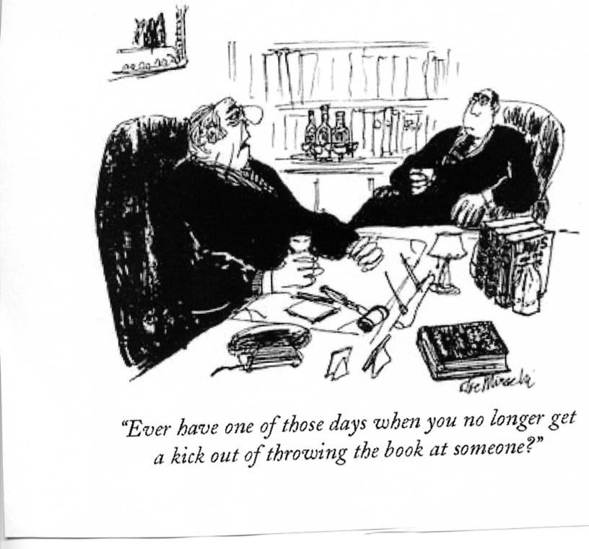
Application of the Sentencing guidelines

Slide 13
The Statutes “Trump” the Guidelines
Regardless of what sentence the guidelines may call for, the sentence imposed must fall within the restrictions set by statute (e.g., statutory maximums and mandatory minimums)

Slide 14
Which Book Applies? – Ex Post Facto
18 U.S.C. § 3553(a)(4)
Use guidelines in effect at sentencing
§1B1.11(b)(2)
“One Book Rule”
§1B1.11(b)(3)
When convicted of two offenses on dates in two different guidelines manual years, use later manual
14
14
Notes:
14
14
14

Slide 15
Introduction, definitions, application principles
Offense guidelines
Generic adjustments
Criminal history
Determining the guideline range
Sentencing procedures & pleas
Violations of probation & supervised release
Sentencing of organizations
Chapters
The Guidelines Manual

Slide 16
Chapter 2 Offense Level

Slide 17
Start with Relevant Conduct
§1B1.3
“I ain’t guilty because I didn’t deal all those drugs they say I did and I don’t know all those people in my conspiracy”

Slide 18
Pointers regarding relevant conduct
The client is held accountable for anything that he does in preparation for the offense, during the offense, or to avoid detection;
The client could be held accountable for the conduct of co-conspirators;
The client can be held accountable for conduct outside the count of conviction (same course of conduct or common scheme or plan) in certain type of cases (e.g. drugs, fraud).
18
18
Notes:
18
18
18

Slide 19
Relevant Conduct
Sets the limits of information to be used in guidelines application
Note however: at sentencing generally ALL information can be used
18 U.S.C. § 3661
§1B1.4
Witte, Watts, Gall etc.

Slide 20
(a)(1) & (a)(2): Analysis
(a)(1)(A): Acts of the defendant
(a)(1)(B): In jointly undertaken criminal activity, reasonably foreseeable acts/omissions of others
WHO
WHEN
Offense of Conviction
(a)(1):
Avoiding detection
In preparation
During
(a)(2):
Same course of conduct/ Common scheme or plan

Slide 21
“Common Scheme or Plan”
§1B1.3(a)(2); App. Note 9(A)
Offenses must be connected to each other by at least one common factor, such as:
Common victims
Common accomplices
Common purpose
Similar modus operandi

Slide 22
“Same Course of Conduct”
§1B1.3(a)(2); App. Note 9(B);
Appendix C, #503
Similarity
Regularity (repetitions)
Temporal proximity
See: U.S. v. Hahn, 960 F.2d 903 (9th Cir. 1992) U.S. v. Hodge, 354 F.3d 305 (4th Cir. 2004)

Slide 23
Determining Scope in a Conspiracy
§1B1.3, Application Note 2
Scope of criminal activity jointly undertaken by a defendant is not necessarily the same as the scope of the entire conspiracy

Slide 24
“Expanded” Relevant Conduct
(i.e., §1B1.3(a)(2) applies) for Offenses Included at §3D1.2(d)
Included: (groupable)
-Drug trafficking
-Fraud, theft, embezzlement
-Money laundering
-Firearms
Excluded: (non-groupable)
-Robbery
-Assault
-Murder
-Kidnapping

Slide 25
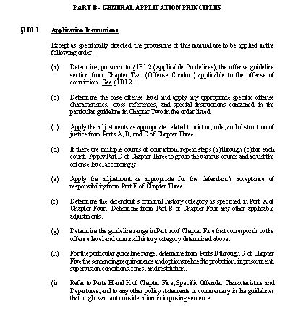

Slide 26
Determining the Applicable Chapter Two Guideline
§1B1.2(a)
Use the Chapter Two guideline applicable to the offense of conviction
Refer to the Statutory Index (Appendix A) in this determination

Slide 27
Appendix A
Statute
Guideline
18 U.S.C. § 2111
2B3.1
18 U.S.C. § 2112
2B3.1
18 U.S.C. § 2113(a)
2B1.1,
2B2.1,
2B3.1,
2B3.2
18 U.S.C. § 2113(b)
2B1.1
18 U.S.C. § 2113(c)
2B1.1
18 U.S.C. § 2113(d)
2B3.1

Slide 28
Appendix A
Section
Charge
§2B1.1
§2B2.1
§2B3.1
§2B3.2
Larceny, Embezzlement, Fraud and Forgery
Burglary
Robbery
Extortion by Force or Threat of Injury or Serious Damage

Slide 29
Structure of a Guideline
Guideline cite (e.g., §2B3.1)
Introductory commentary
(e.g., Chapter Three, Part B)
Guideline
Chapter Two guidelines
Base offense levels
Specific offense characteristics (SOC)
Cross references
Special instructions
29
Notes:
29

Slide 30
Structure of a Guideline (cont.)
Commentary
Statutory provisions
Application notes
Background
Historical note
30
Notes:
30

Slide 31
§2B3.1 Robbery
(a) Base Offense Level: 20
(b) Specific Offense Characteristics Levels
(1) financial institution or post office +2
(2) firearm, weapon, death threat +2 to +7
(3) victim injury +2 to +6
(max. of 11 offense levels from (b)(2) & (b)(3))

Slide 32
§2B3.1 Robbery
(b) SOC’s (cont’d) Levels
(4) abduction +4
restraint +2
(5) carjacking +2
(6) taking of a firearm,
destructive device,
or controlled substance +1
(7) loss of $10,000+ to $5 million+ +1 to +7
(c) Cross Reference
(1) if victim murdered, apply the guideline
for First Degree Murder (§2A1.1)

Slide 33
§2D1.1 Drug Trafficking, Etc.
Base Offense Level (apply the greatest): Level
(3) the offense level from the Drug Quantity Table except if mitigating role (§3B1.2) applies:
BOL Reduction
32 -2
34 or 36 -3
38 -4

Slide 34
Drug Quantity Table Base Offense Levels for Cocaine
150 KG
Level 38
50 KG
Level 36
15 KG
Level 34
5 KG
Level 32
3.5 KG
Level 30
2 KG
Level 28
500 G
Level 26

Slide 35
§2D1.1 Drug Trafficking, Etc.
(b) Specific Offense Characteristics
(1) firearm, dangerous weapon possessed
* * *
(11) if defendant meets the subdivision criteria of “the safety valve” (§5C1.2)
Level
+2
-2

Slide 36
Sentencing Below a Mandatory Minimum
Substantial Assistance
18 U.S.C. § 3553(e)
“Safety Valve”
18 U.S.C. § 3553(f)

Slide 37
“Safety Valve”
18 U.S.C. § 3553(f) and §5C1.2

Slide 38
“Safety Valve”
18 U.S.C. § 3553(f)
Court makes determination; no government motion required
Sentence without regard to the mandatory minimum
Downward departures possible for mitigating factors

Slide 39
§5C1.2 – “The Safety Valve”
The Court shall impose a sentence in accordance with the applicable guidelines without regard to any statutory minimum sentence, if the court finds the defendant meets the criteria:
No more than 1 criminal history point
No violence, threat of violence, firearm or other dangerous weapon used
No death or serious bodily injury
No leadership role enhancement
Before sentencing, truthfully provides info regarding offense/relevant conduct

Slide 40
Understanding the “Safety Valve”
Not discretionary: either applicable or not
See U.S. v. Mejia-Pimental, 477 F.3d 1100 (9th Cir. 2007)
Relevant time frame: sentencing hearing
Subsection (5) “information” is different than §3E1.1 or §5K1.1
Court’s decision; government can contest

Slide 41
Chapter 3

Slide 42
Chapter Three Adjustments
Victim-Related Adjustments
Role in the Offense
Mitigating Role (§3B1.2)
Obstruction
Multiple Counts
Acceptance of Responsibility (§3E1.1)

Slide 43
Acceptance of Responsibility
Chapter Three, Part E
2-Level Reduction:
If defendant clearly demonstrates affirmative acceptance of responsibility for the offense.
1-Level Additional Reduction Possible

Slide 44
Requirements for 1-Level Additional Reduction
§3E1.1(b)
Only if 2-level reduction applicable
Must be at least offense level 16
Government motion required
Must give timely notification of plea of guilty

Slide 45
Apply the Grouping Rules
Identify groupable versus non-groupable counts
Groupable if:
Same victim, act transaction
Common objective, common scheme or plan
Offense level calculated from harm or loss
Lists of groupable versus non groupable
Apply grouping rules to determine combined offense level

Slide 46
Criminal History
Chapter Four

Slide 47
Criminal History Points Prior Offense Committed at 18 or Older
Time Frame
Points* Sentence
(Earliest Date of Relevant Conduct)
3 >13 months
2 ≥60 days
1 All others**
Within 15 yrs. of prior sentence imposition or release
Within 10 yrs. of prior sentence imposition
Within 10 yrs. of prior sentence imposition
(max of 4)
* If otherwise countable ** Exceptions may apply

Slide 48
Criminal History Points Prior Offense Committed Before 18
Time Frame
Points* Sentence
(Earliest Date of Relevant Conduct)
3 Only if convicted as an adult and >13 months
2 ≥ 60 days
1 All others**
Within 15 yrs. of prior sentence imposition or release
Within 5 yrs. of prior sentence imposition or release
Within 5 yrs. of prior sentence imposition
(max of 4)
* If otherwise countable ** Exceptions may apply

Slide 49
Length of Prior Sentences
§4A1.2(a) and App. Note 2
Set by maximum sentence imposed
If sentence or any portion is suspended, the maximum is established by the unsuspended portion
Unaffected by release
E.g., release to parole or for “good time”
49
Notes:
49

Slide 50
Other Determinations Regarding Prior Sentences - §4A1.2
Types of sentences never counted, e.g.,
Foreign sentences
Tribal sentences
Certain misdemeanors (see §4A1.2(c)(1) & (2))
Relationship of prior sentences and relevant conduct
50
Notes:
50
50

Slide 51
Other Determinations Regarding Prior Sentences - §4A1.2
Treatment of multiple prior sentences
Counted separately or as a single prior sentence
Prior revocations of supervision
Pardons, set asides, expunged convictions, and diversionary dispositions
Various other rules
51
Notes:
51
51

Slide 52
Chapter Three and Chapter Four “Overrides”
§3A1.4
Terrorism
§ § 4B1.1-4B1.2
Career Offender
§4B1.3
Criminal Livelihood
§4B1.4
Armed Career Criminal
§4B1.5
Repeat and Dangerous Sex Offender Against Minors

Slide 53
Supreme Court Cases Involving “Violent Felonies” or “Crime of Violence”
Begay v. U.S., 128 S.Ct. 1581 (2008)
New Mexico DUI statute not a violent felony under Armed Career Criminal (ACCA)
Key question: “whether the crime involves purposeful, violent, and aggressive conduct”
Chambers v. U.S., 129 S.Ct. 687 (2009)
Illinois failure to report offense is not a “violent felony” under the ACCA
James v. U.S., 550 U.S. 192 (2007)

Slide 54
Pointers regarding criminal history
Make sure you check every prior offense
Examine the length of the prior offense closely
For multiple prior offenses, examine arrest dates closely – see if multiple prior offenses can be “scored” as single sentences
Check for “expunged” convictions
Examine enhancements based on prior convictions very closely – Supreme Court cases (e.g. Begay, Chambers)
54
Notes:
54

Slide 55
Chapter Five

Slide 56
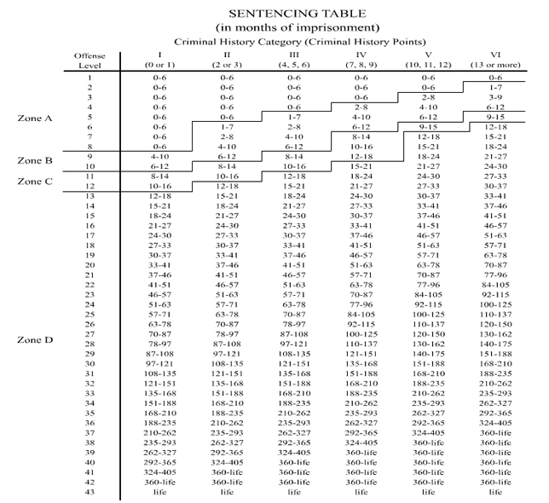

Slide 57
Other Aspects of Sentence
Probation
Supervised release
Restitution, fines, assessments, forfeitures
Sentencing options
Undischarged terms (consecutive/concurrent)

Slide 58
Guidelines Manual Departures
Chapter Five, Part K
§5K1.1 Substantial Assistance
§5K2.0 – 2.23 Grounds for Departure and other specific departures
§5K3.1 Early Disposition Programs
Chapter Five, Part H – Specific Offender Characteristics

Slide 59
Guidelines Manual Departures (cont.)
§4A1.3 – Inadequacy of Criminal History Category
Other specific commentary

Slide 60
Some guideline pointers
Make sure your client is only held accountable for his own relevant conduct;
Seek a mitigating role adjustment (§3B1.2);
Make sure criminal history category has been calculated correctly;
Make sure certain predicate offenses for recidivist enhancements are actually crimes of violence or violent felonies;
Make sure the court is using the correct guideline manual (ex post facto);
Don’t forget about “traditional” departures.

Slide 61
The Sentencing Memorandum

Slide 62
Section 3553(a) factors
Court must consider:
Nature and circumstances of the offense
History and characteristics of defendant
These types of considerations were often forbidden/discouraged factors under guidelines
e.g. age, good works, family ties or responsibilities, good works, physical condition or appearance, socio-economic status

Slide 63
Section 3553(a) factors (continued)
Court must impose a sentence “sufficient, but not greater than necessary” (AKA parsimony provision) to achieve purposes of sentencing:
Need for sentence to reflect:
Seriousness of offense
Promote respect for law
Achieve just punishment
Adequate deterrence
Protect public from further crimes of defendant
Kinds of sentences available
Applicable guideline range
Sentencing Commission policy statements
Need to provide restitution to victims

Slide 64
Position of Sentences in Relation to Guideline Range FY 2009
Below Guideline Range 41.2%
Other Below 15.9%
Other Govt 12.9%
Within Guideline Range 57.0%
§5K1.1 12.4%
Above Guideline Range 1.8%
SOURCE: U.S. Sentencing Commission, Fourth Quarter FY09 Quarterly Sentencing Update. .

